Slide 1
Turtlebot Trajectory Generation and Tracking
Controls Project
Shubham Jain
Yash Shukla

Slide 2
Control Lyapunov Barrier Functions
The value of Barrier function (BF) on a given point of interest increases to infinity as the point approaches the boundary of a given unsafe region.
In dynamical systems, a Lyapunov function (LF) helps to determine the stability of the system.
Control Barrier Functions (CBF) and Control Lyapunov Functions (CLF) are extensions of BF and LF to control theory.
That being said, quadratic programming can be used to combine CLF and CBF to achieve the control objectives specified by CLF and the constraint conditions specified by CBF.

Slide 3
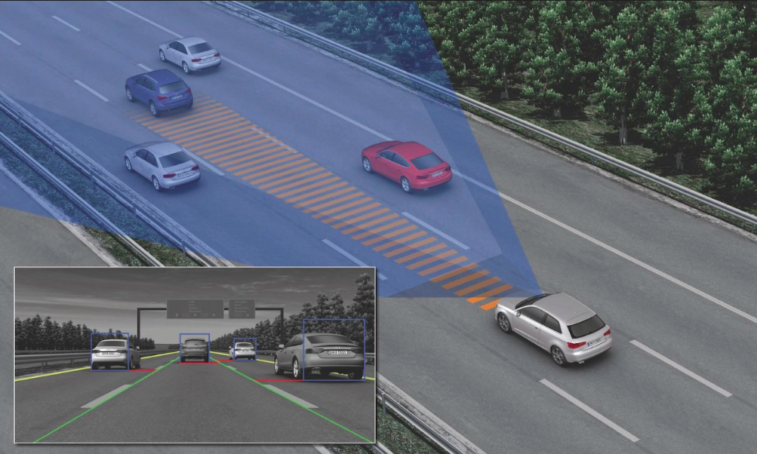
Adaptive Cruise Control
Driver assistive technology that can be used predominantly on highways.
Helps car maintain a certain desired velocity
Adjusts speed in response to surrounding vehicles
Major challenge is handling conflicting objectives - velocity and safety.
CLBF can be used to achieve ACC, which requires achieving a desired speed with constraints defined by the safety distance with respect to the vehicles in vicinity.

Slide 4
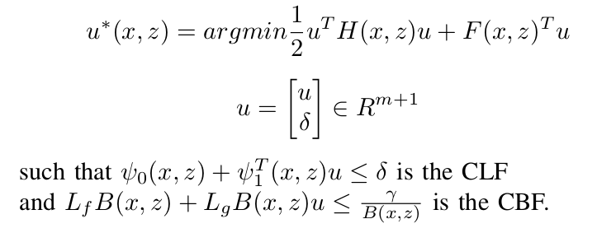
Problem Statement
Goal: Combine BF (hard constraints) and LF (soft constraint) for the goal of trajectory tracking of a self-driving car .
Quadratic programming combines CLF and CBF into a single controller
Implementation on TurtleBot present at CIRL.

Slide 5
Implementation on Turtlebot

Slide 6
Overall Strategy
Vicon system in CIRL lab used for getting position and orientation inputs of turtlebot and obstacle
Velocity estimates calculated using raw inputs
Median filter applied to position, velocity and orientation values before passing to controller
Controller calculates velocity, acceleration, angular velocity for turtlebot
Outputs of controller filtered and passed forward to turtlebot actuators in the form of a velocity and angular velocity reading

Slide 7
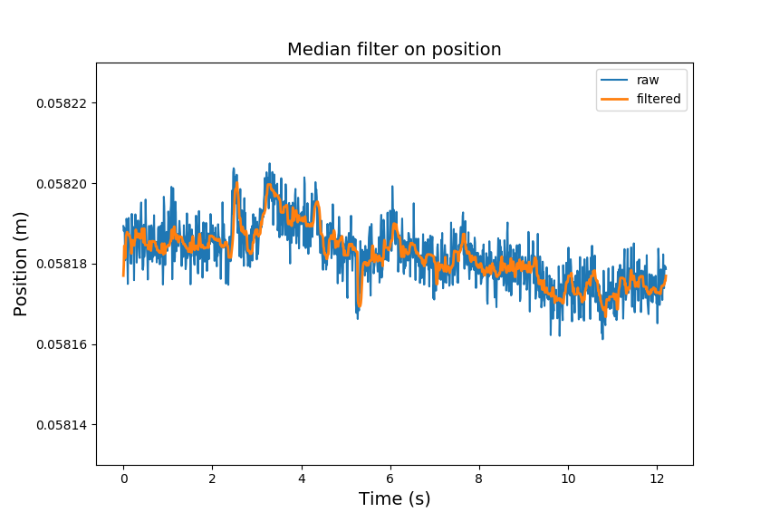
Filtering Input
Input values such as position and orientation received from vicon are noisy
Applied a median filter of window 10 to smooth input values.

Slide 8
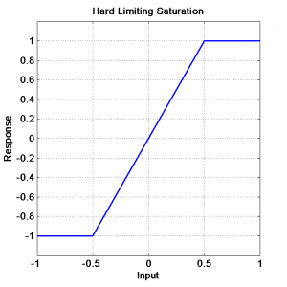
Actuator saturation
The turtlebot has a lower saturation limit of 0.04 m/s which means that it remains at rest given an input velocity less than this value
We maintain an internal velocity in controller which ensures command velocity is not affected by saturation limits.

Slide 9
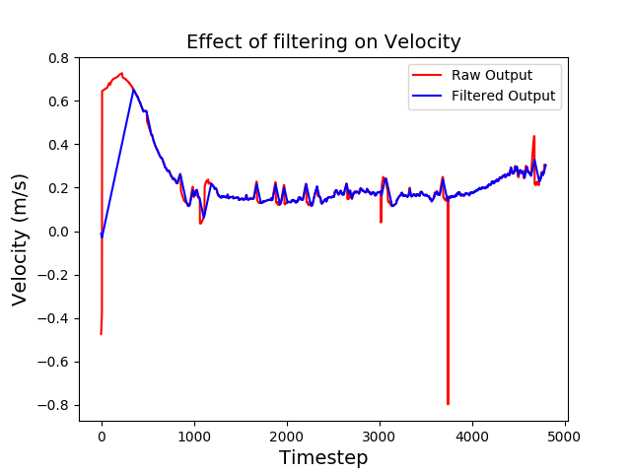
Filtering Velocity Output
1D case: Output of controller is acceleration of ego car. Hence sudden spikes in controller output automatically smoothen out
2D case: Output of controller is velocity of ego car. Output was filtered by increasing/decreasing in uniform steps when spike is higher than a threshold.

Slide 10
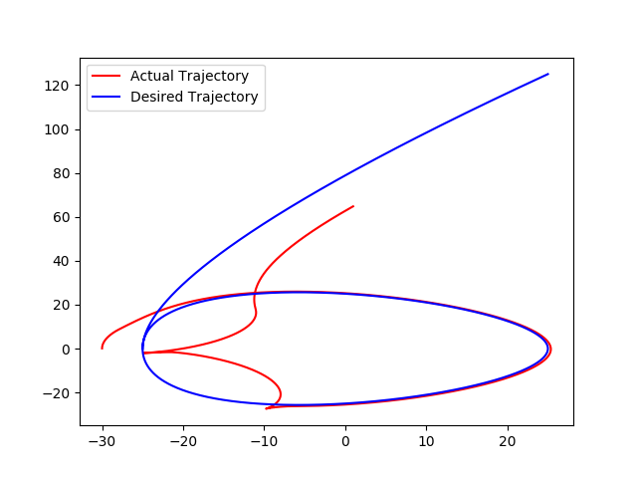
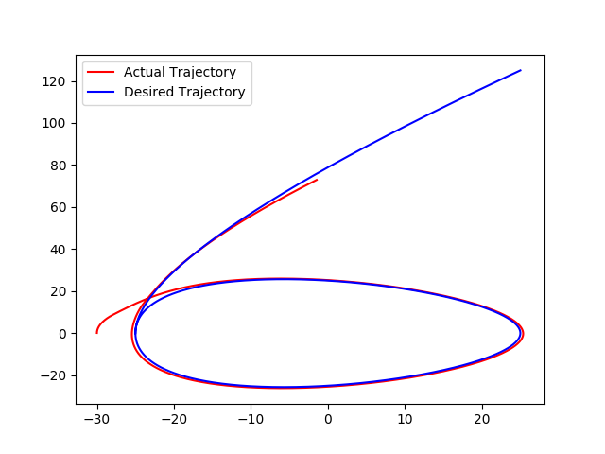
Measuring angular errors
Care should be taken while measuring angular errors, since angles are circular.
For example, error between an angle of 179 and -179 degrees should be 2º
This can be achieved by ensuring angular error lies in range [0, 180]

Slide 11
Results

Slide 12
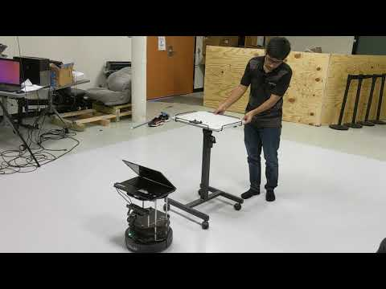

Slide 13
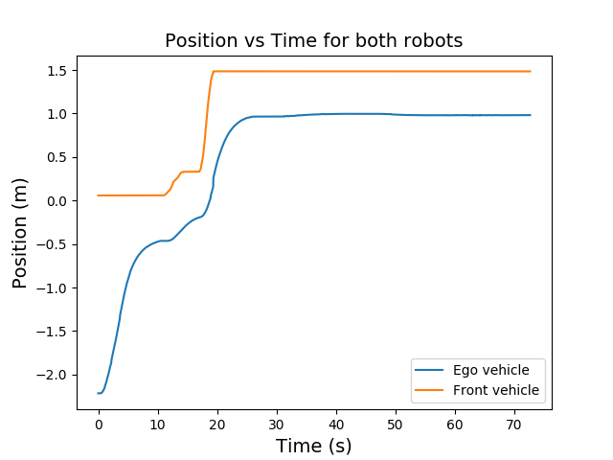
One Dimensional ACC
Goal - Maintain desired velocity while keeping a safe distance from obstacle

Slide 14
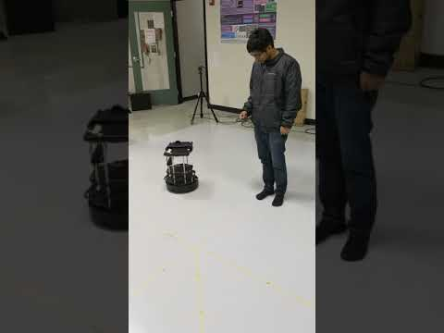

Slide 15
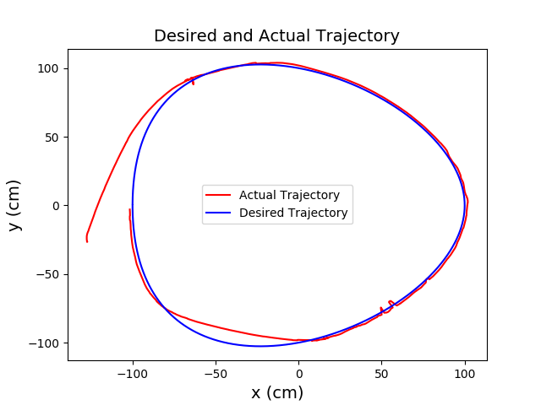
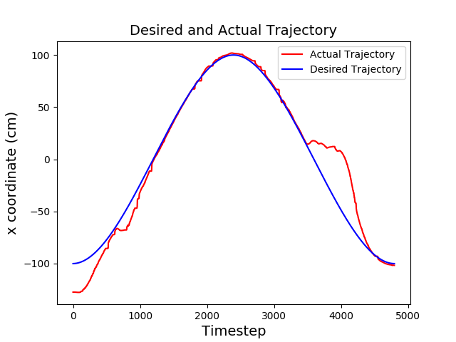
Two Dimensional ACC
Goal - Follow desired circular trajectory while maintaining safe distance from obstacle

Slide 16
Conclusion
Goals accomplished:
Implemented 2D ACC in python.
Dealt with practical challenges of implementation such as noisy inputs, outputs and actuator saturation limits.
Successfully implemented ACC using CLBF on turtlebot for both 1D and 2D cases
Implemented all communication in the form of ROS nodes to make communication and logging of data convenient.

Slide 17
Future Work
The angular velocity of turtlebot is somewhat irregular and work can be done to smoothen it.
The ego vehicle tries to exactly satisfy its hard constraint, which is not possible due to lag and noise in real-world data. Hence it oscillates around the boundary point. This can be improved by providing a kind of buffer zone for stopping
The ego vehicle may not always find a way to circumvent around the obstacle. Sometimes it stops in front of the obstacle waiting for an unhindered path.

Slide 18
References
[1] A. D. Ames, J. W. Grizzle, P. Tabuada, ”Control barrier function based quadratic programs with application to adaptive cruise control”, Proc. IEEE 53rd Annu. Conf. Decis. Control, pp. 6271-6278, Dec. 2014.
[2] M. Z. Romdlony, B. Jayawardhana, ”Stabilization with guaranteed safety using control Lyapunov barrier function”, Automatica, vol. 66, pp. 39-47, 2016.
[3] X. Xu, J. W. Grizzle, P. Tabuada, A. D. Ames, ”Correctness guarantees for the composition of lane keeping and adaptive cruise control”, 2016, [online] Available: http://arxiv.org/abs/1609.06807.
[4] A.D. Ames, K. Galloway, K. Sreenath, J.W. Grizzle, ”Rapidly exponentially stabilizing control lyapunov functions and hybrid zero dynamics”, Automatic Control IEEE Transactions on, vol. 59, no. 4, pp. 876-891, April 2014.
[5] Q. Nguyen, K. Sreenath, ”Exponential control barrier functions for enforcing high relative-degree safety-critical constraints”, Proc. American Control Conf., pp. 322-328, 2016.
[6] Romdlony, M.Z. and Jayawardhana, B. (2014). Uniting control Lyapunov and control barrier functions. In IEEE Conference on Decision and Control, 22932298.

Slide 19
Thank You
Questions?

